Slide 1
ANALYSING WIRELESS CAPSULE ENDOSCOPY IMAGES USING DEEP LEARNING FRAMEWORKS TO CLASSIFY DIFFERENT GI TRACT DISEASES
Final Thesis Presentation
Author: Rupesh Kumar Dey
TP Number: TP061720

Slide 2
Introduction & Background
GI tract related diseases are one of the most prevalent diseases in our community.
Important for early detection in order for early prevention treatments.
3 common methods of endoscopy which are Gastroscopy, Colonoscopy and Wireless Capsule Endoscopy (WCE). This study focuses on WCE.
WCE not widely accepted in industry and Drs are required to spend hours to go through thousands of images (50K to 120K). Tiring and inefficient.
Growing interest to automate the entire process to accurately capture / detect these diseases using CAD technology to help lessen the burden of Drs.

Slide 3
Problem Statements
Besides Self-developed Transfer Learning Feature Extraction architectures, there is a lack of work exploring transfer learning fine tuning and ensemble model development techniques.
1
Lack of work studying how image processing enhancement can be leveraged as a pre-processing step. Present works only focus on very high level image processing such as simple Gaussian blurring and Laplacian sharpening. Not much focus on colour, contrast and illumination enhancement.
2
Augmentation techniques used are only geometric augmentation techniques. There is a lack of techniques that manipulate the image in terms of contrast, colour and illumination.
3

Slide 4
Aim
Design and develop a generalized multiclass CNN classification algorithm to be used in CAD system for diagnosis of various GI tract diseases by analysing WCE GI tract images with varying tract lining lesions.
Objectives
To research, design and develop suitable CNN classification models to diagnose various GI tract diseases based on analysis of WCE images. This encompasses basic model design, framework selection, architectures, and parameter tuning.
1
To research, design and develop suitable image processing enhancement techniques as a pre-processing step to enhance the quality features in the raw images to further improve the performance of the developed solution.
2
3
To analyse and perform exploratory data analysis on the data to understand its characteristics.
4
To study and implement alternative non-geometric based data augmentation methods to create a more generalized dataset for developing the solution.

Slide 5
Overall Methodology
Stage 1

Slide 6
Stage 2
Stage 3

Slide 7
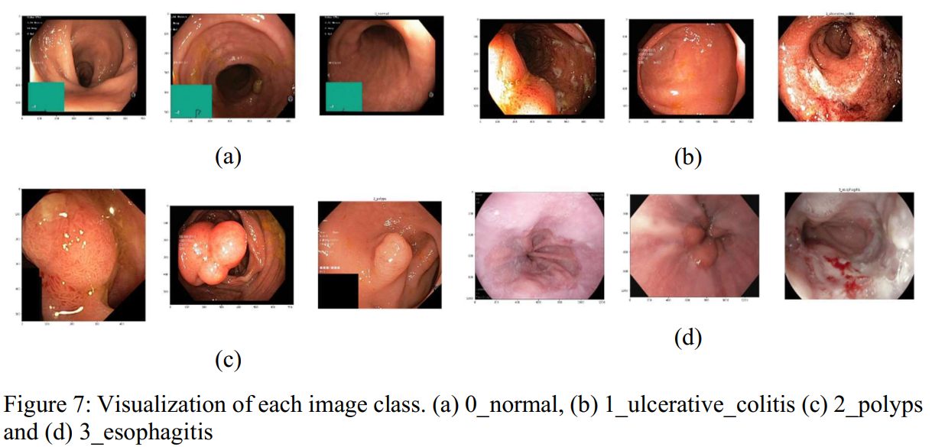
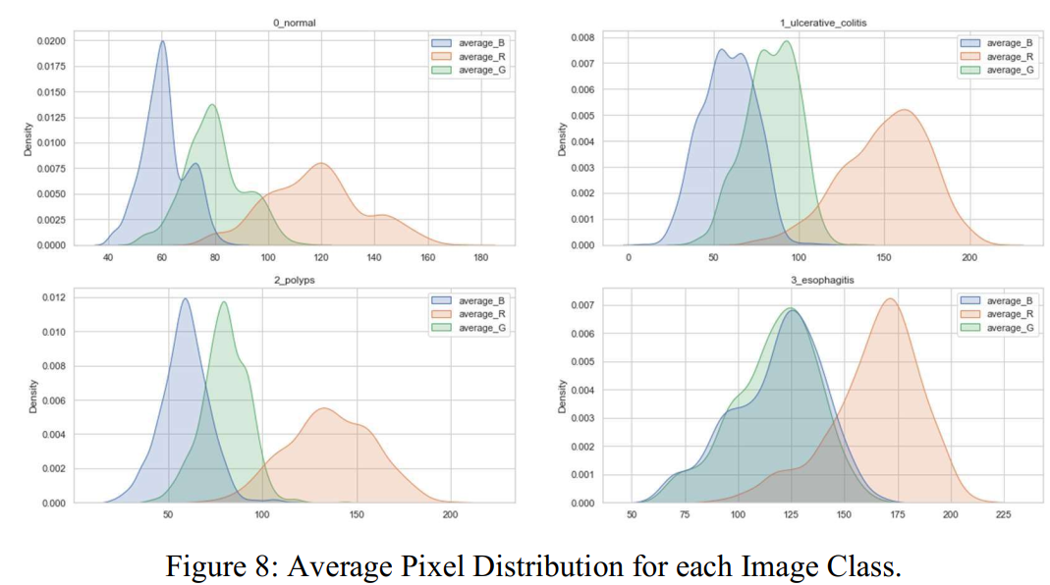
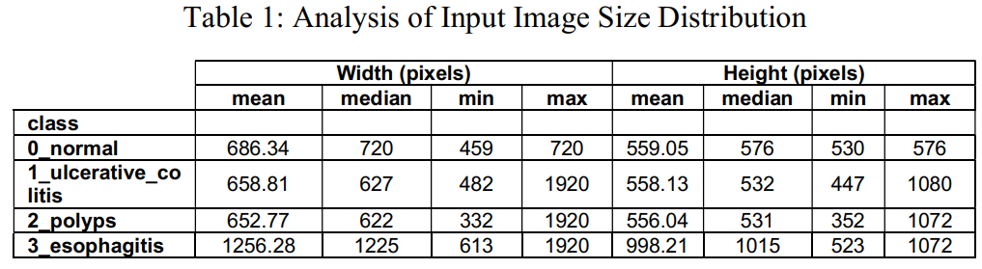
Stage 3: Data Analysis
Pixel Distribution of Images
Visualize Images
Statistical Data on Image Size

Slide 8
Image Enhancement + Augmentation

Slide 9
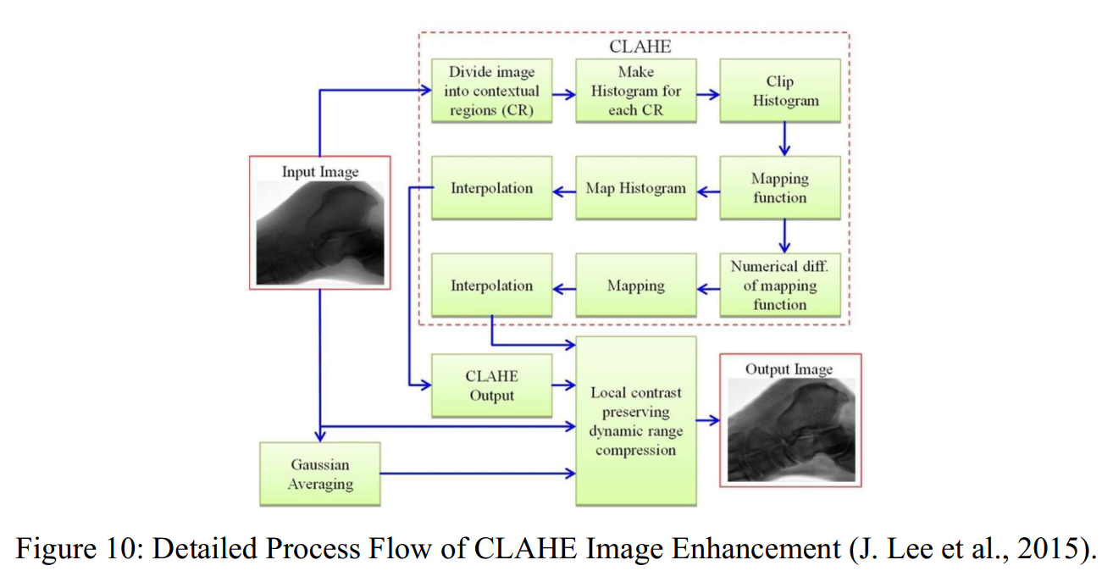
CLAHE
MULTISCALE
RAYLEIGH

Slide 10
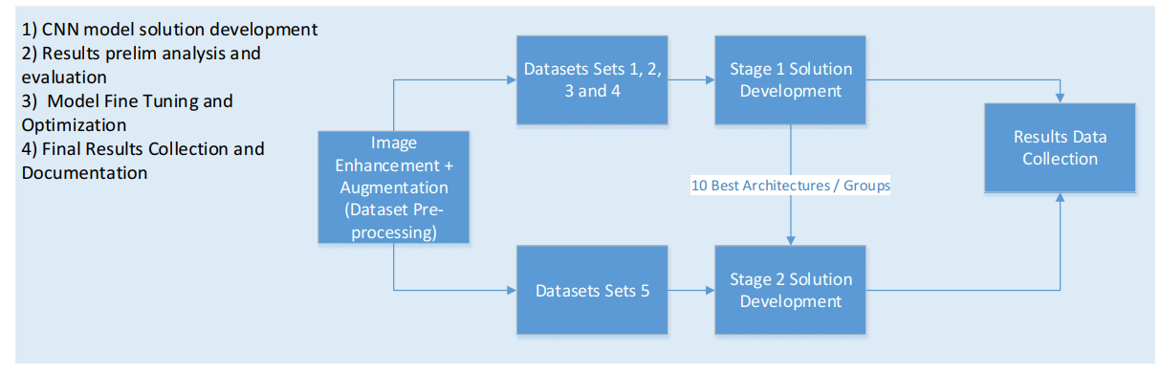
CNN Solution Development Overall

Slide 11
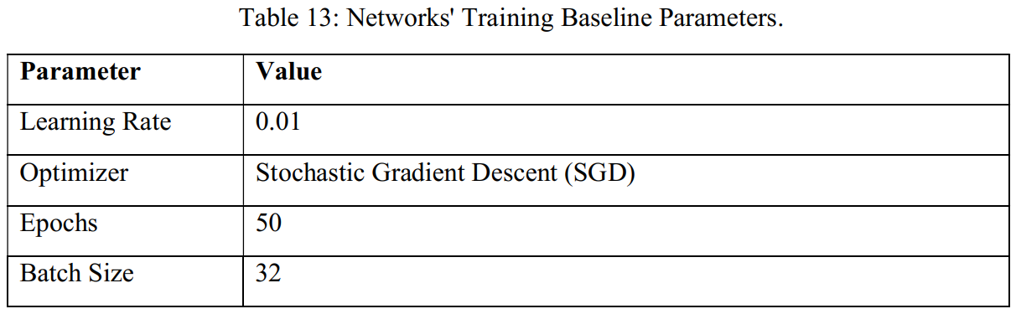
Baseline Settings for Network Architectures

Slide 12
CNN Solution Development – Stage 1

Slide 13
CNN Solution Development – Stage 2

Slide 14
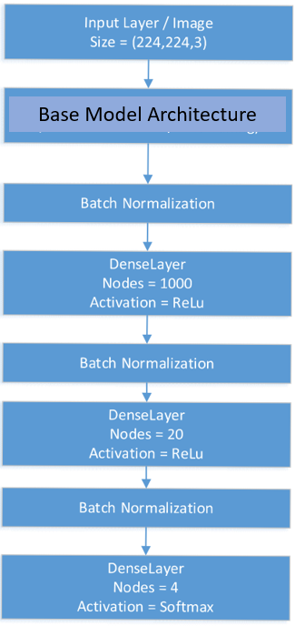
Models Developed
BASE MODEL 1
BASE MODEL 2
Transfer Learning – (ResNet & MobileNet) (Feature Extraction & Fine Tuning)

Slide 15












Libraries Used

Slide 16
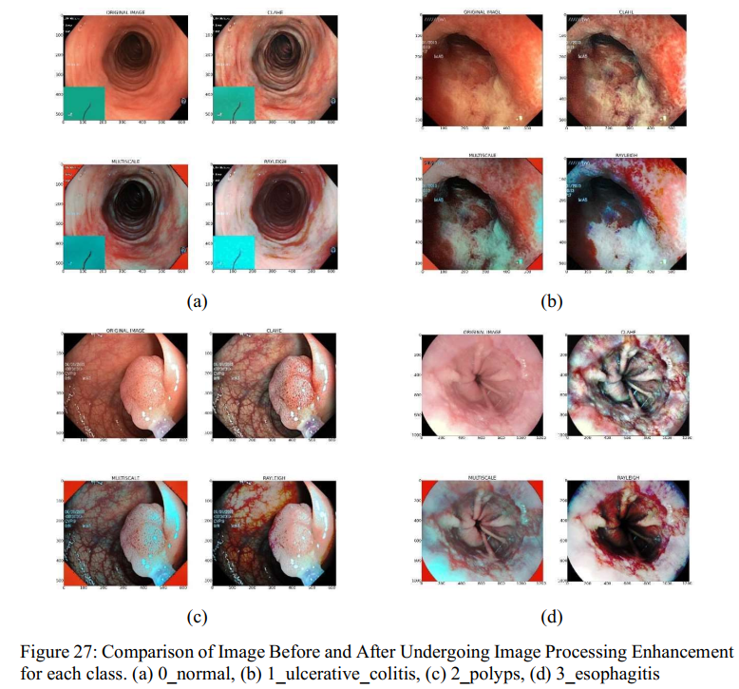
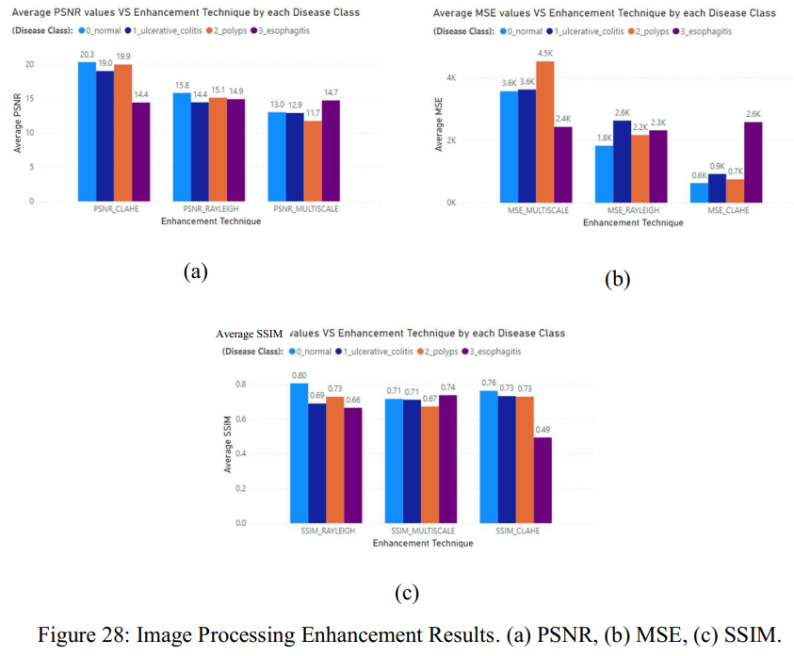
Results – Image Processing
Visualization and Comparison of Processed Image
PSNR, MSE and SSIM Values

Slide 17
Evaluation metrics
ValTestAverage (Primary) & F1 Score (Secondary)
Testing / Validation Accuracy was not used solely as the main metric for evaluation
During initial results analysis, it was observed that a significant number of models shared the same test accuracy and F1-score value.
Made it difficult to properly evaluate the results
Validation and test set used during testing contained 1200 test images for each testing dataset set and 600 validation images for each validation dataset set, amounting to a total of 1800 images which in overall is a sufficient amount of data to properly test and evaluate the performance of the models.
The F1-score metric was considered as a secondary metric to validate the ValTestAvg accuracy results obtained. The F1-score considered the harmonic mean of two more important metrics which are precision and recall.
The F1-score is typically used as the main metric for evaluation in circumstances where the distribution of data quantity is imbalanced between each class. However, this was not the case in this study where the data was equally distributed between each class making accuracy the better suited candidate as the primary evaluation metric

Slide 18
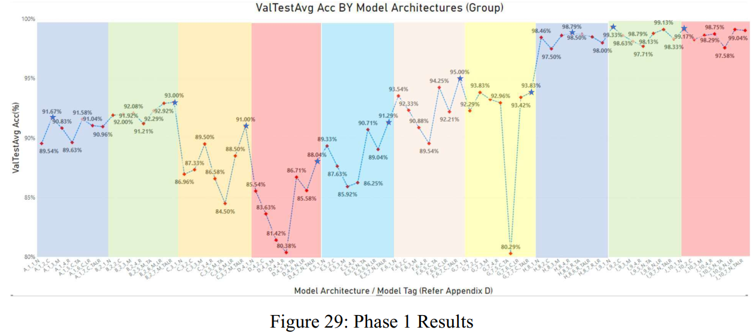
CNN Model Results – Phase 1

Slide 19
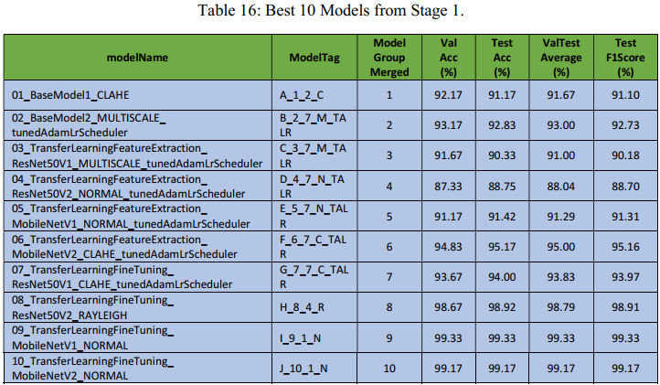
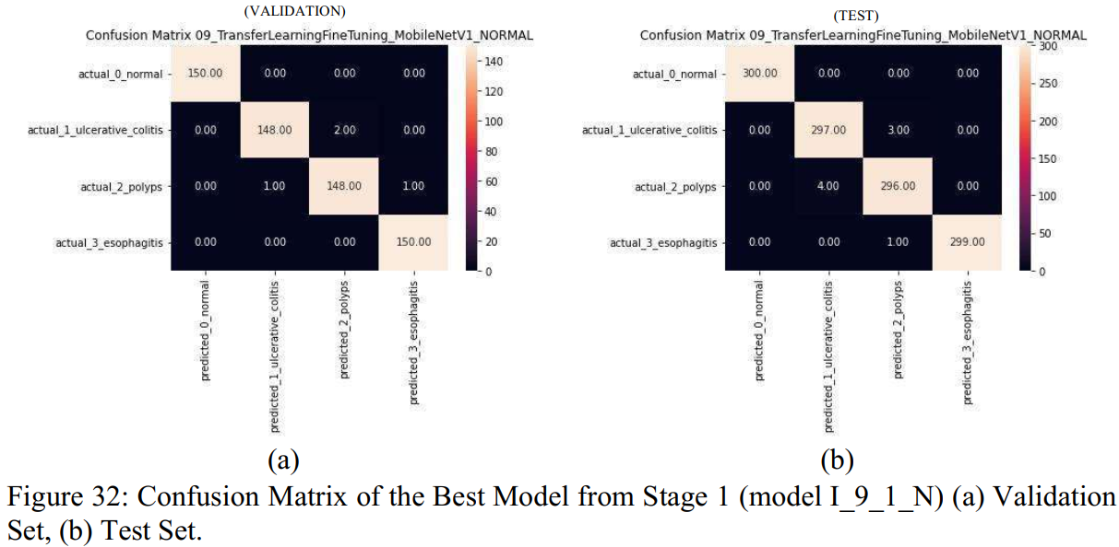
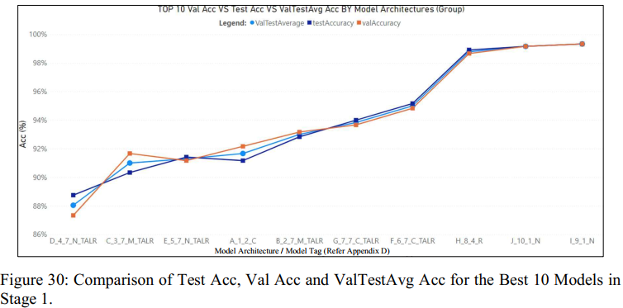
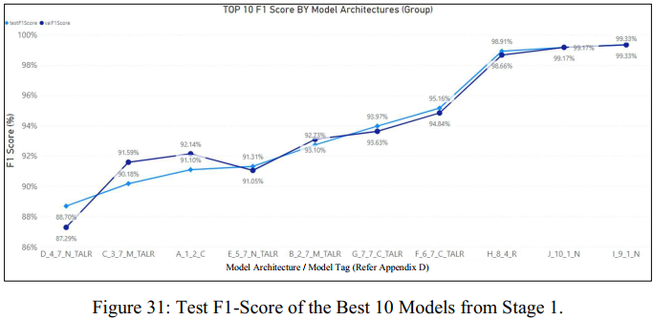
CNN Model Results – Phase 1

Slide 20
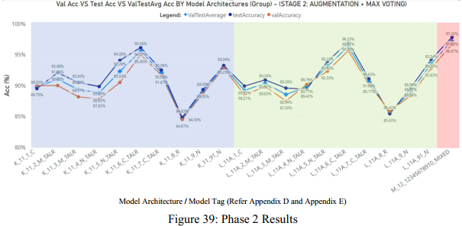
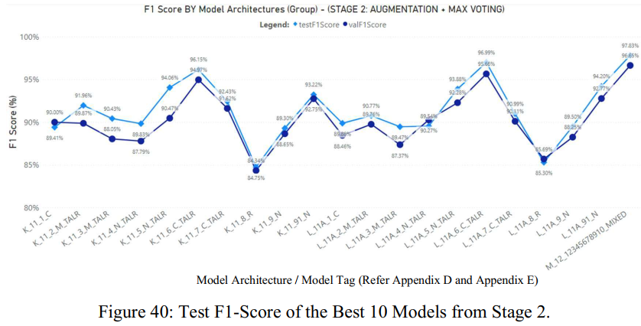
CNN Model Results – Phase 2

Slide 21
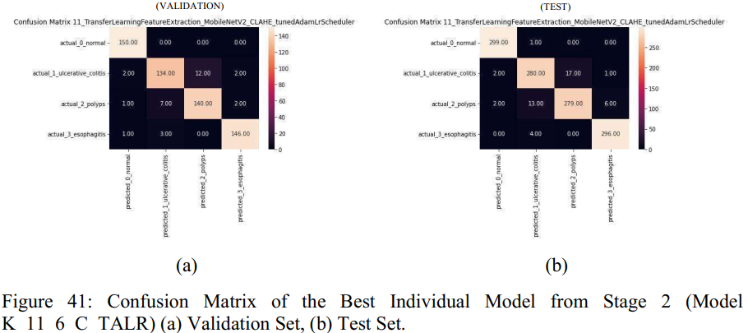
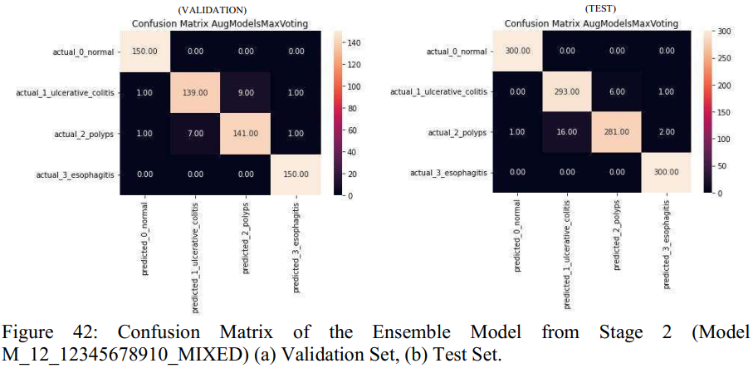
CNN Model Results – Phase 2

Slide 22
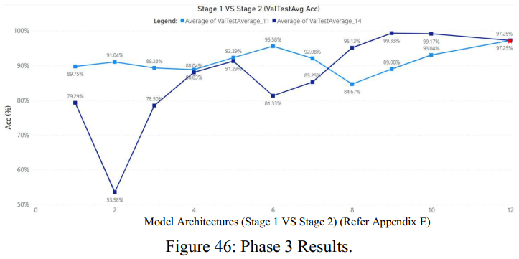
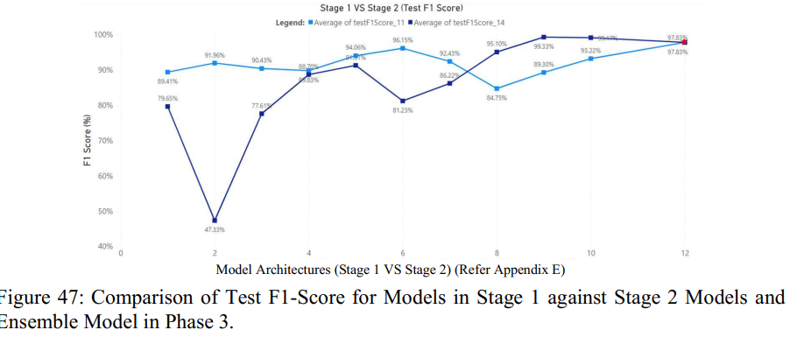
CNN Model Results – Phase 3

Slide 23
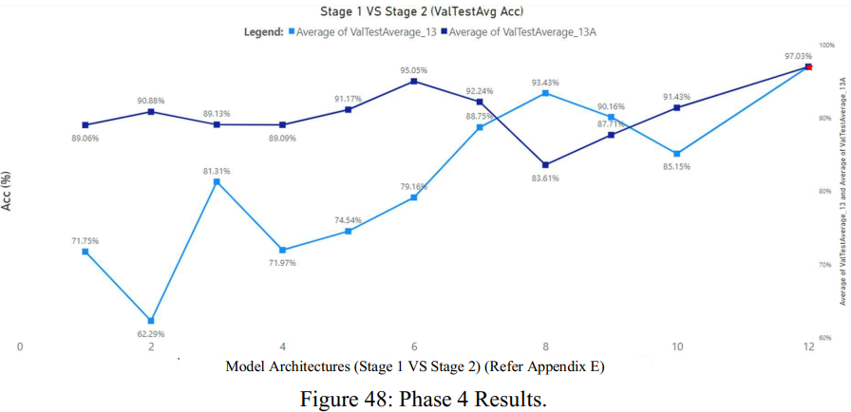
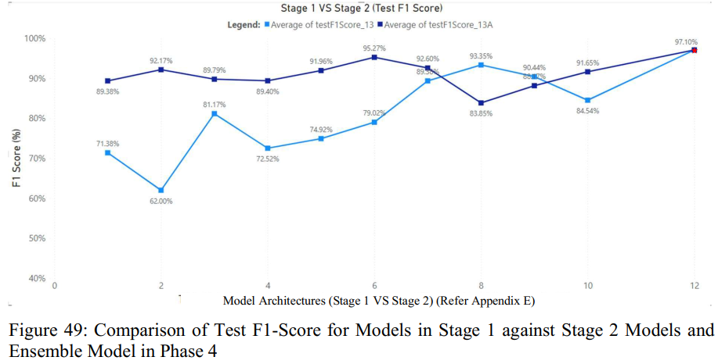
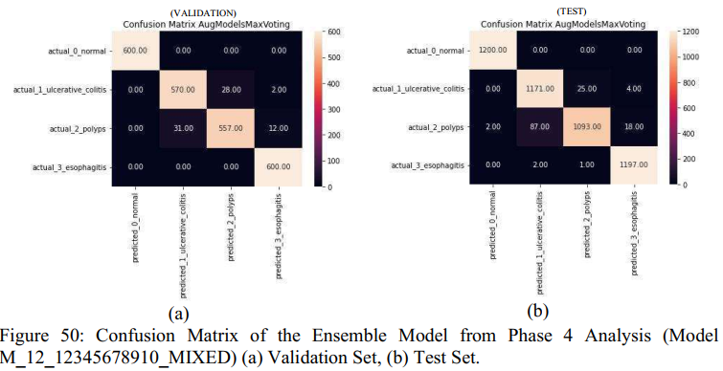
CNN Model Results – Phase 4

Slide 24
Discussion Of Contributions and Findings
Image Processing Enhancement as a Data Pre-Processing Step
Some architectures performed better with image processing enhancement whilst others did not. However, across the board, image processing-based models performed with good results
Image processing and creating different sets of datasets enabled large scale development and testing of CNN models.
Performing Data Augmentation
Alternative to geometric augmentations
Centred around creating more variety of images as opposed to increasing the dataset size and leveraged on image processing to create these variety of images.
Simulates contrast and different image capturing quality from different WCE cameras. Enables the model to be dynamic.
Network Architectures
Allowed a more comprehensive solution development by segregating solution development into 2 separate stages
Ensemble the best as it leverages the inferencing from different network architectures.
Fine tuning better as compared to the Self Developed and Feature Extraction models.
Optimization is important in improving the model’s results.

Slide 25
Conclusions
An end-to-end detailed methodology defined to develop the CNN solution.
Image processing enhancements techniques were adopted, implemented on the dataset and analysed. Enhancement techniques focused on more complex image manipulation such as colour, texture, contrast and illumination.
4 different datasets were created i.e., datasets Set 1 to Set 4
Additional augmentation dataset, Set 5 was created by leveraging on image processing. Centred around colour contrast and illumination augmentation as opposed to commonly used geometric augmentation. This aims to improve the developed solution’s generalization capability.
A total of 91 CNN models were developed and this was broken down into 2 stages of Stage 1 and Stage 2. The CNN solution development encompassed various network architectures, transfer learning techniques, mode of solutions, network architecture
Best model in terms of generalization is the Ensemble model of architecture.

Slide 26
Limitations
Automate the entire developed methodology and CNN solution into a Machine Learning pipeline that can be packaged, deployed, and tested in real life applications.
Increase the number of classes or diseases to detect.
More research should be poured into exploring and studying even more techniques especially those that are prominent in the medical imaging domain.
Extending detection to localisation of these lesions within an image using object detection models such as YOLO, Single Shot Detection and FasterRNN.

Slide 27
THANK YOU Q&A

